Slide 1

Developing and Implementing a Summer Course Refresher Bootcamp
Dr. Kiwanna Brackett
Associate Dean, Business and Computers
York Technical College
Notes:
Welcome, everyone! I’m Dr. Kiwanna Brackett, Association Dean for the Business and Computer programs at York Technical College. Today, I’m excited to share the journey and impact of our Summer Course Refresher Bootcamp.

Slide 2
Workshop Agenda
Welcome
Background and Rationale
Bootcamp Objectives, structure, and implementation
Outcomes and Lessons Learned
Notes:
Here’s a quick overview of what we’ll cover today—from the background and rationale behind the bootcamp to its structure, outcomes, and what’s next.
Workshop Agenda: Summer Course Refresher Bootcamp
Welcome and Opening Remarks
Introduction to the Business Administration Department
Purpose of the Workshop
Background and Rationale
Why the Bootcamp Was Created
Departmental Needs and Strategic Goals
Bootcamp Objectives
Enhance Course Quality and Relevance
Improve Student Learning Outcomes
Foster Faculty Collaboration
Integrate Technology and Accessibility
Bootcamp Structure and Implementation
Planning and Preparation Timeline
Faculty Participation and Roles
Session Topics and Activities
Key Workshop Sessions Overview
Reviewing Course Goals and Learning Outcomes
Analyzing Course Content and Success Metrics
Incorporating Active Learning and Technology
Enhancing Assessment Methods
Ensuring Accessibility and Inclusivity
Outcomes and Impact
Faculty Feedback and Reflections
Course Improvements Implemented
Student Success Indicators
Best Practices and Lessons Learned
What Worked Well
Challenges and Solutions
Recommendations for Future Bootcamps
Interactive Q&A and Discussion
Sharing Ideas and Experiences
Open Forum for Questions
Closing Remarks and Next Steps
Continuing Course Improvement
Opportunities for Collaboration and Support

Slide 3
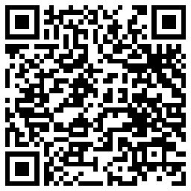
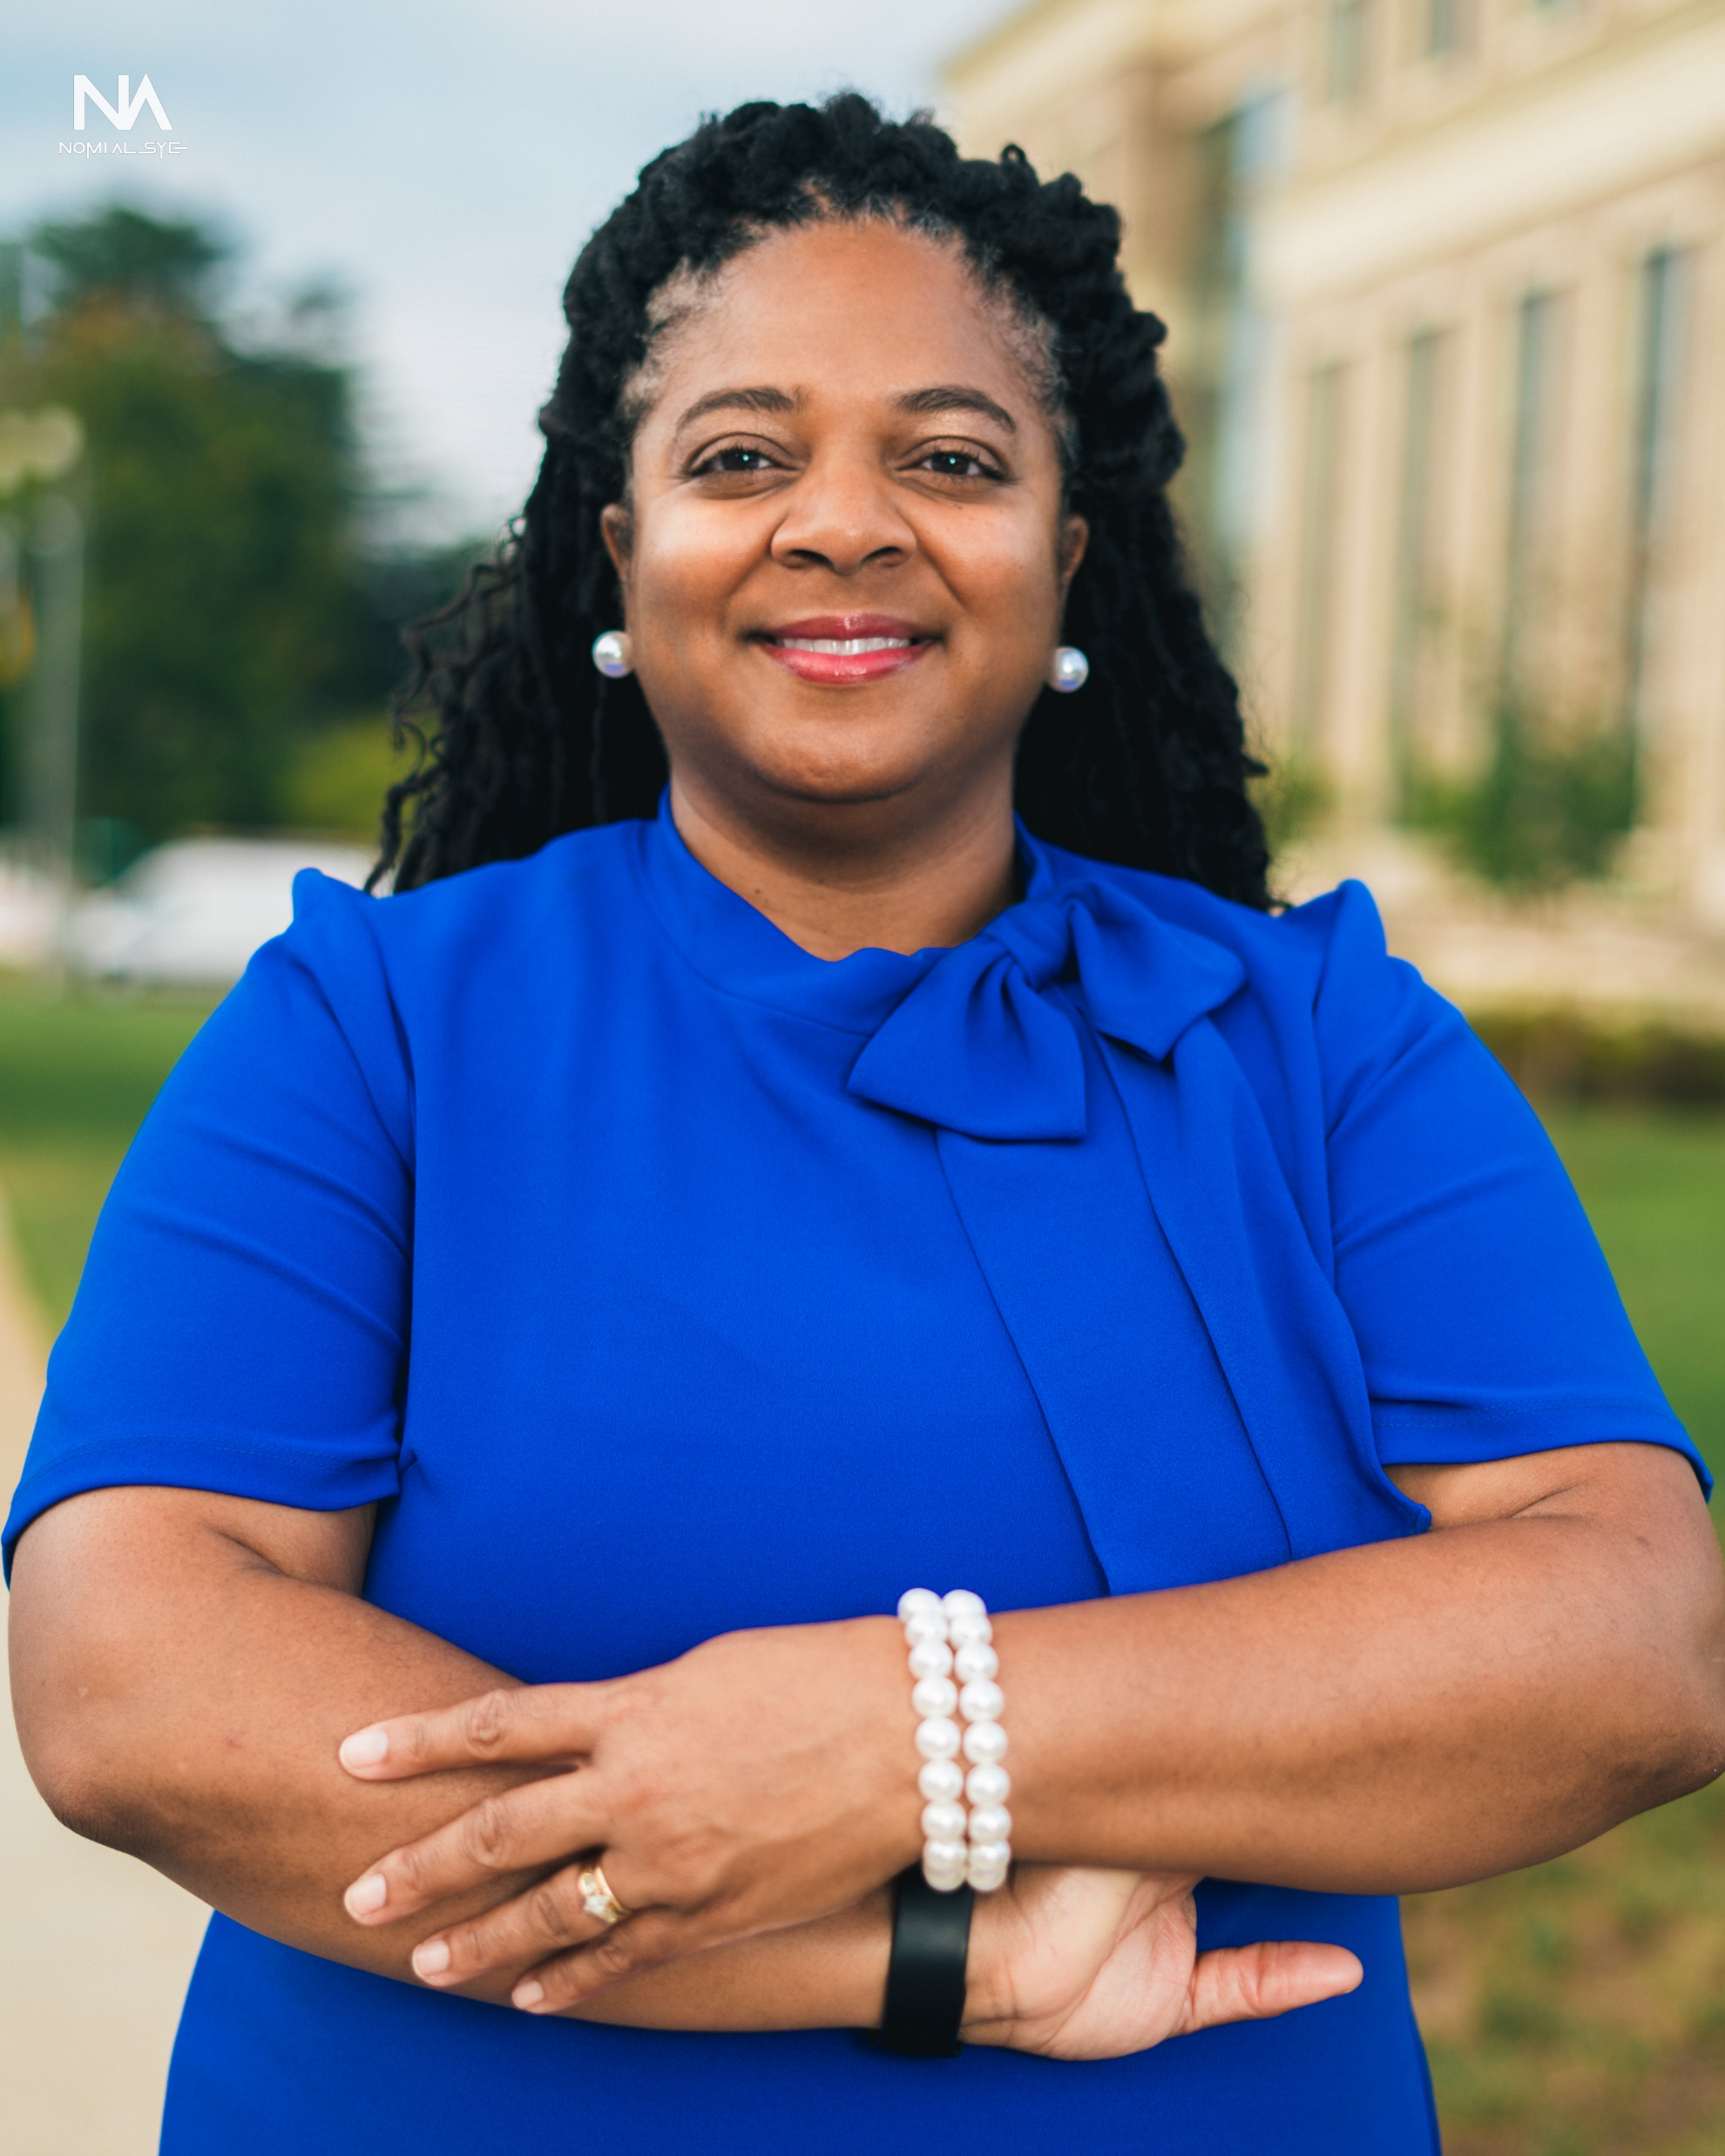
Introduction
Dr. Kiwanna Brackett
Associate Dean, Business and Computers
York Technical College
Notes:
A bit about me—my background spans over 18 years in education and leadership. I’m passionate about creating environments that support both student and faculty growth.
ABOUT THE PRESENTER
DR. KIWANNA BRACKETT, the Department Chair of Business Administration at York Technical College, will lead the workshop on Developing and Implementing a Summer Course Refresher Bootcamp. With over 18 years of experience in training and development, human resources, and program development, Dr. Brackett has held various leadership roles, including AOT Department Chair, Program Coordinator, and Corporate and Continuing Education Program Manager. She has been instrumental in launching innovative programs across higher education, non-profit, and for-profit sectors. Dr. Brackett is passionate about fostering environments that encourage personal and professional growth and has been recognized with the NISOD Excellence Award and the League for Innovation in the Community College Excellence Award. Her academic credentials include a Doctor of Education in Organizational Leadership, two Master's degrees, a Bachelor's degree in Psychology, and a Diploma in Medical Billing and Coding.

Slide 4

Background and Rationale
Why the Bootcamp was created
Departmental Needs and Strategic Goals
Notes:
We launched the bootcamp to address departmental needs and align our courses with evolving industry standards. This slide outlines how we approached integrating those standards into our curriculum.
🎯 Why the Bootcamp Was Created
“The idea for the Summer Course Refresher Bootcamp emerged from a clear need to strengthen the quality and consistency of our course offerings.”
“We recognized that while our faculty were doing great work, there wasn’t a structured opportunity to step back, reflect, and refine our courses in a collaborative and data-informed way.”
“The bootcamp was designed to provide that space—where faculty could come together, share insights, and work toward a common goal of continuous improvement.”
🧭 Departmental Needs and Strategic Goals
“Our department had several strategic priorities that the bootcamp directly supported.”
First, we needed to ensure our courses remained aligned with current industry standards to better prepare students for the workforce.
Second, we aimed to improve student outcomes by addressing gaps in engagement, assessment, and accessibility.
Third, we wanted to foster a culture of collaboration—where faculty could learn from one another and grow together.
*And finally, we sought to integrate technology and inclusive practices more intentionally into our course design.”
Implementing industry standards into business courses is crucial to ensure that students are equipped with the knowledge and skills needed to succeed in their future careers. Here's a discussion on how to effectively integrate industry standards into business courses:
1. Research and Identify Relevant Industry Standards: Begin by researching the specific industry or industries that the business courses will focus on. Identify the key standards, regulations, best practices, and trends that are pertinent to those industries. This may involve consulting with professionals working in the field, industry publications, and regulatory bodies.
2. Incorporate Industry-Relevant Case Studies and Examples: Integrate real-world case studies and examples that illustrate how industry standards are applied in practice. These case studies can help students understand the relevance and implications of adhering to industry standards in various business contexts.
3. Invite Guest Speakers from the Industry: Invite professionals from relevant industries to serve as guest speakers or guest lecturers in the business courses. These industry experts can provide firsthand insights into industry standards, current practices, challenges, and opportunities. They can also engage in discussions with students and answer questions related to industry standards.
4. Align Course Content with Industry Certifications: Many industries have certifications that validate specific skills and knowledge. Aligning course content with these certifications can help students prepare for industry-recognized credentials. Incorporate relevant topics covered in certification exams into the curriculum and provide resources to support students in pursuing certifications.
5. Offer Experiential Learning Opportunities: Provide opportunities for students to engage in experiential learning activities that simulate real-world business scenarios. This could include internships, co-op programs, consulting projects, business simulations, or industry-specific workshops. Through these experiences, students can apply theoretical knowledge and gain practical insights into industry standards.
6. Integrate Industry-Standard Tools and Technologies: Familiarize students with industry-standard tools, software, and technologies commonly used in the business field. Incorporate hands-on activities and assignments that require students to utilize these tools to analyze data, develop business plans, create financial models, or conduct market research.
7. Encourage Critical Thinking and Problem-Solving Skills: Emphasize the importance of critical thinking and problem-solving skills in navigating complex business environments governed by industry standards. Provide opportunities for students to analyze case studies, evaluate ethical dilemmas, and propose solutions that align with industry regulations and best practices.
8. Assess Mastery of Industry Standards: Design assessments that measure students' understanding and mastery of industry standards. This may include exams, projects, presentations, or portfolios that require students to demonstrate their ability to apply industry knowledge and adhere to relevant standards.
9. Continuous Curriculum Review and Updates: Stay abreast of changes in industry standards and practices by regularly reviewing and updating the business courses. Incorporate new developments, emerging trends, and revisions to industry regulations into the curriculum to ensure its relevance and currency.
By incorporating industry standards into business courses through these strategies, educators can better prepare students for the demands of the professional world and equip them with the skills needed to excel in their chosen field.

Slide 5
Share your Experiences in the Chat
What challenges have you faced in keeping your courses current and engaging?
How does your department currently support faculty in course refreshment or redesign?

Slide 6
Course Refresher Bootcamp Objectives
Enhance
Enhance Course Quality
Improve
Improve Student Outcomes
Foster
Foster Collaboration
Integrate
Integrate Technology
Ensure
Ensure Accessibility
Notes:
“Our bootcamp was built around five core goals: enhancing course quality, improving student outcomes, fostering collaboration, integrating technology, and ensuring accessibility.”
As Chair of the Business Administration Department, I recognized the need for a structured approach to course improvement and faculty collaboration. That’s why I launched the Summer Course Refresher Bootcamp. This initiative was designed with five key goals in mind:
To enhance course quality by ensuring our curriculum stays aligned with current industry standards and best practices.
To improve student outcomes by refining our instructional strategies and increasing student success rates.
To foster collaboration among faculty, creating a space where we can collectively review, reflect, and enhance our course content.
To integrate technology by incorporating modern tools and multimedia that enrich the learning experience.
And to ensure accessibility by designing inclusive learning environments that support the success of all students.
This bootcamp wasn’t just about course updates—it was about building a culture of continuous improvement and shared responsibility for student learning.”
As the chair of the Business Administration department, I decided to implement the Summer Course Refresher Bootcamp for several reasons:
1. Enhance Course Quality: To ensure that our courses remain relevant and up-to-date with industry standards.
2. Improve Student Outcomes: To help students achieve better learning outcomes and success rates.
3. Foster Collaboration: To encourage collaboration among faculty members in reviewing and enhancing course content.
4. Integrate Technology: To incorporate modern technology and multimedia tools into our courses.
5. Ensure Accessibility: To create inclusive and accessible learning environments for all students.

Slide 7
Share your Experiences
Which of the bootcamp goals—enhancing quality, improving outcomes, fostering collaboration, integrating tech, or ensuring accessibility—resonates most with your institution’s needs?
What strategies have you used to improve student learning outcomes in your courses?

Slide 8
Bootcamp Structure and Implementation
Summer 2024
Notes:
“We used a structured approach—weekly meetings, enhancement plans, and professional development.” This helped us stay focused and collaborative throughout the process.”

Slide 9
Course Refresher Bootcamp Structure
Weekly Departmental Meetings
Course Enhancement Plan developed
Reporting Checklist
Instructor Selected Benchmarks
Course development plan
Selected Professional Development
On demand ITE professional development courses
In person training (during department meetings)
Department Chair review and feedback
Notes:
“We used a structured approach—weekly meetings, enhancement plans, and professional development.” This helped us stay focused and collaborative throughout the process.”
To support the implementation of the Summer Course Refresher Bootcamp, we established a structured and collaborative process within the department. We held weekly departmental meetings that served as a platform for planning, sharing progress, and providing peer support.
As part of this initiative, we developed a comprehensive Course Enhancement Plan. This included a reporting checklist, instructor-selected benchmarks, and individualized course development plans to guide faculty through the improvement process.
To support professional growth, we offered a blend of on-demand ITE professional development courses and in-person training sessions during our department meetings. These opportunities allowed faculty to explore new strategies and tools at their own pace while also engaging in collaborative learning.
Throughout the process, I provided ongoing review and feedback as Department Chair to ensure alignment with departmental goals and to maintain momentum. This structured approach helped us stay focused, accountable, and connected as we worked to enhance course quality and student success.”

Slide 10
Share your Experiences
How do you currently involve faculty in course improvement initiatives?
What professional development formats have been most effective for your team—on-demand, in-person, or hybrid?

Slide 11
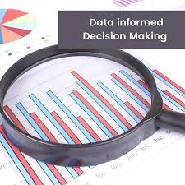
Analyzing Course Content
Course Materials and Resources
Data Points Analyzed:
  Course Success Rates
  DFW Course Data
  Learning Outcome data
  Course Accessibility scores
Industry Standards
Strengths and Weaknesses
Student Engagement Best Practices
Notes:
“We reviewed a range of data—success rates, DFW data, learning outcomes, and more—to guide our course improvements and ensure alignment with student needs.”
Reviewing Course Goals and Learning Outcomes
Analyzing Course Content and Success Metrics
Incorporating Active Learning and Technology
Enhancing Assessment Methods
Ensuring Accessibility and Inclusivity
As part of the Bootcamp, we conducted a comprehensive review of course materials and resources to ensure alignment with learning outcomes and student needs. This process was data-informed and collaborative. Let me walk you through the key data points we analyzed:”
📊 1. Course Success Rates
“We began by examining overall course success rates to identify patterns in student achievement and areas where performance could be improved.”
⚠️ 2. DFW Course Data (Drop, Fail, Withdraw)
“We looked closely at DFW rates to pinpoint courses with high attrition or failure rates, which helped us prioritize where to focus our redesign efforts.”
🎯 3. Learning Outcome Data
“We assessed how well students were meeting established learning outcomes, using both direct and indirect measures, to evaluate instructional effectiveness.”
♿ 4. Course Accessibility Scores
“Accessibility was a major focus. We used tools to evaluate how accessible our course content was for all learners, including those with disabilities.”
🏢 5. Industry Standards
“We benchmarked our course content against current industry standards to ensure our students are gaining relevant, real-world skills.”
🔍 6. Strengths and Weaknesses
“Faculty identified both strengths and areas for improvement in their courses, which informed the development of targeted enhancement plans.”
👥 7. Student Engagement Best Practices
“We also reviewed best practices for student engagement, integrating strategies that promote active learning, collaboration, and motivation.”
“By grounding our course enhancement efforts in data and evidence-based practices, we were able to make meaningful improvements that support both faculty development and student success.”

Slide 12
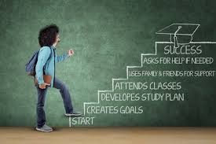
Reviewing Course Goals and Objectives
Review Course Goals/Outcomes
Existing Course Objectives
Identifying Gaps and Areas for Improvement
Notes:
“Revisiting course goals helped us ensure relevance and rigor.” We used tools like Bloom’s Taxonomy and curriculum mapping to identify gaps and align objectives.”
Reviewing and revising course goals is a foundational step in implementing a successful Summer Course Refresher Bootcamp. It ensures that course content remains aligned with current academic standards, industry expectations, and student needs. Here's a breakdown of its importance and strategies to support this work:
🎯 Why Reviewing Course Goals Matters
Ensures Relevance and Rigor
Revisiting course goals helps align them with evolving industry standards, accreditation requirements, and institutional priorities.
Improves Learning Outcomes
Clear, measurable goals guide the development of assessments and instructional strategies that directly support student success.
Identifies Gaps and Redundancies
A thorough review can reveal outdated content, missing competencies, or unnecessary overlap with other courses.
Supports Faculty Collaboration
Engaging faculty in this process fosters shared ownership of curriculum quality and promotes consistency across sections.
🛠️ Strategies to Support Course Goal Review and Revision
✅ 1. Review Course Goals and Outcomes
Compare current goals with program-level outcomes and industry standards.
Use Bloom’s Taxonomy to ensure goals reflect appropriate cognitive levels.
Ask: “What should students be able to do by the end of this course?”
✅ 2. Analyze Existing Course Objectives
Evaluate whether objectives are specific, measurable, and aligned with course goals.
Use a curriculum mapping tool to visualize alignment between objectives, content, and assessments.
✅ 3. Identify Gaps and Areas for Improvement
Review student performance data (e.g., DFW rates, assessment results).
Gather faculty and student feedback on course clarity and relevance.
Benchmark against peer institutions or professional standards.
✅ 4. Facilitate Collaborative Workshops
Use departmental meetings or bootcamp sessions to engage faculty in reviewing and revising goals.
Provide templates and rubrics to guide the revision process.
✅ 5. Document and Share Revisions
Maintain a shared folder (e.g., in Microsoft Teams) with updated course goals and rationale for changes.
Encourage ongoing reflection and updates as part of a continuous improvement cycle.

Slide 13
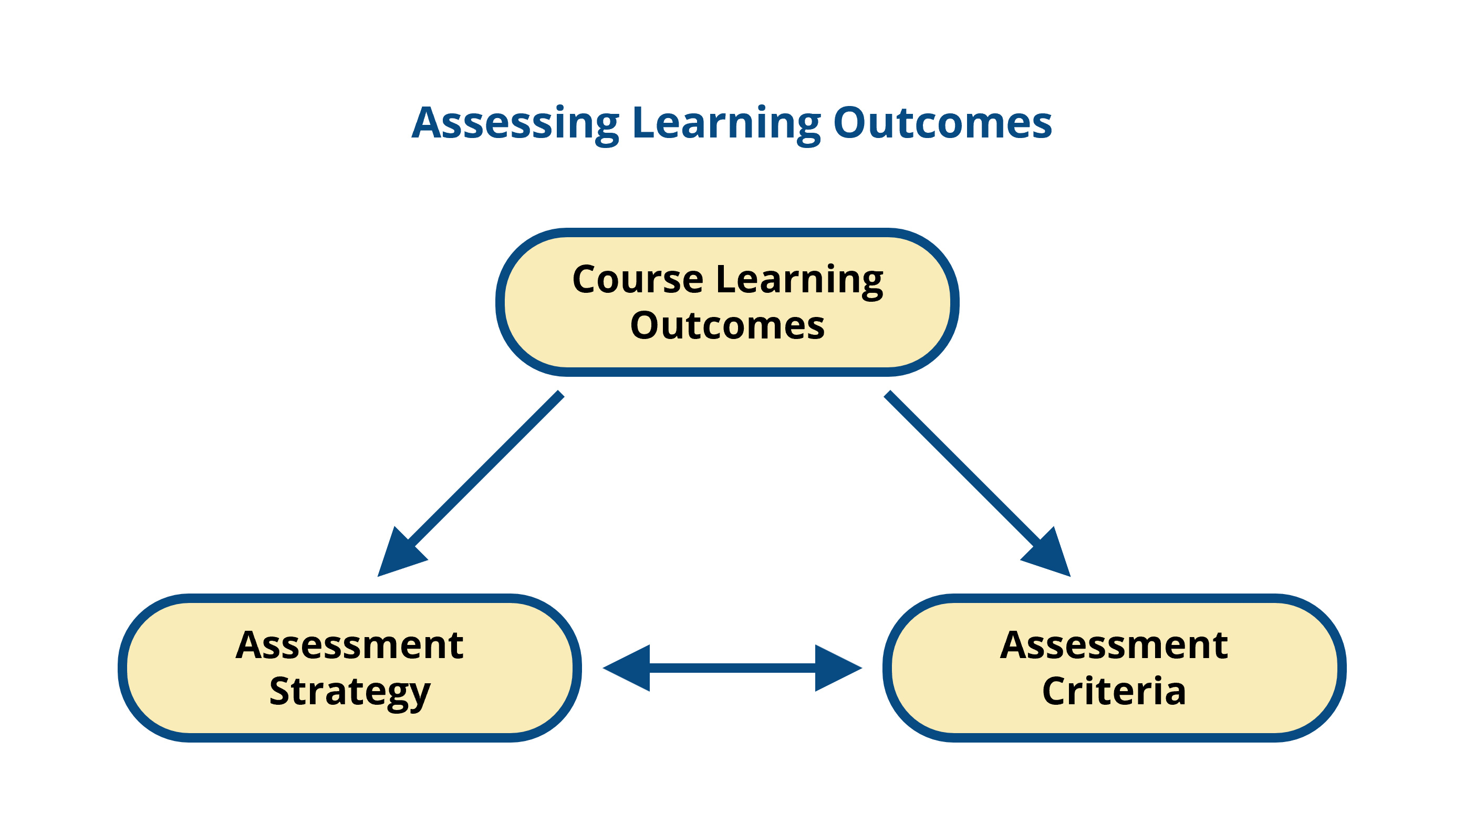
Assessing Learning Outcomes
Defining Learning Outcomes within the course
Alignment with Course Goals
Measuring Learning Outcomes
Notes:
“We focused on defining clear learning outcomes, aligning them with course goals, and using both direct and indirect methods to measure student achievement.”
To effectively assess learning outcomes in courses, it's essential to follow a structured approach that ensures clarity, alignment, and measurable results. Here's a breakdown of the key components from your presentation:
🎯 1. Defining Learning Outcomes Within the Course
Definition: Learning outcomes are clear, concise statements that describe what students are expected to know, do, or value by the end of a course or module.
Best Practices:
Use action verbs from Bloom’s Taxonomy (e.g., analyze, create, evaluate).
Ensure outcomes are specific, measurable, achievable, relevant, and time-bound (SMART).
Focus on student performance, not instructor activity.
Example:
“By the end of this course, students will be able to design a marketing plan for a new product using industry-standard tools.”
🔗 2. Alignment with Course Goals
Definition: Ensuring that learning outcomes are directly connected to the broader goals of the course and program.
Strategies:
Map each learning outcome to course content, activities, and assessments.
Use a curriculum alignment matrix to visualize connections.
Align outcomes with institutional or accreditation standards.
Benefits:
Promotes coherence across the course.
Helps students understand the purpose of each activity.
Supports continuous improvement and accountability.
📏 3. Measuring Learning Outcomes
Definition: The process of evaluating whether students have achieved the intended learning outcomes.
Methods:
Direct Measures: Exams, projects, presentations, portfolios, and performance tasks.
Indirect Measures: Surveys, reflections, course evaluations, and focus groups.
Rubrics: Provide clear criteria for evaluating performance consistently.
Tips:
Use pre- and post-assessments to measure growth.
Collect both quantitative and qualitative data.
Analyze results to identify trends and areas for improvement.

Slide 14
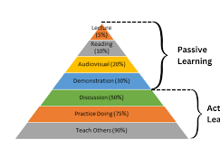
Incorporating Active Learning Strategies
Active Learning Techniques
Engaging Students
Designing Active Learning Exercises
Notes:
“Active learning was a major focus. We explored techniques like think-pair-share, case studies, and simulations to boost engagement and deepen learning.”
Here’s a detailed exploration of engagement strategies that support student learning, based on the themes from your presentation:
🔹 Active Learning Techniques
Definition: Instructional methods that actively involve students in the learning process, encouraging them to participate, reflect, and apply knowledge.
Examples:
Think-Pair-Share: Students think individually, discuss with a partner, then share with the class.
Case Studies: Real-world scenarios that require analysis and decision-making.
Problem-Based Learning (PBL): Students solve complex, open-ended problems collaboratively.
Interactive Polling: Tools like Kahoot or Mentimeter to check understanding in real time.
Role-Playing or Simulations: Students take on roles to explore perspectives and practice skills.
🔹 Engaging Students
Definition: Creating a learning environment that captures students’ interest, motivates them to learn, and encourages active participation.
Strategies:
Personalized Learning Paths: Allow students to choose topics or formats for assignments.
Frequent Feedback: Provide timely, constructive feedback to guide improvement.
Real-World Relevance: Connect content to current events or industry practices.
Collaborative Projects: Encourage teamwork and peer learning.
Instructor Presence: Maintain regular communication and visible involvement in online spaces.
🔹 Designing Active Learning Exercises
Definition: Creating structured activities that require students to engage cognitively, socially, and physically with the content.
Design Tips:
Align with Learning Outcomes: Ensure each activity supports course goals.
Scaffold Complexity: Start with simple tasks and build toward more complex challenges.
Use Multimedia: Incorporate videos, infographics, or interactive tools to enhance engagement.
Encourage Reflection: Include prompts that ask students to reflect on what they learned and how they learned it.
Assess Participation: Use rubrics or self-assessments to evaluate engagement and learning.

Slide 15
Share your Experiences
What active learning strategies have you found most effective in your own teaching?
How do you ensure your course content aligns with industry standards and student needs?

Slide 16

Integrating Technology and Multimedia
Use of Technology in Course Delivery
Multimedia Tools
Effective Integration of Technology
Notes:
“We introduced a variety of tools—from video platforms to gamified learning apps—to make our courses more interactive and accessible.”
Here’s a curated list of multimedia technologies that can significantly enhance student engagement in online and hybrid courses:
🎥 Video & Interactive Media
Kaltura / Panopto / YuJa – Platforms for recording, editing, and embedding interactive video quizzes.
Edpuzzle – Turns videos into interactive lessons with embedded questions.
Flip (formerly Flipgrid) – Enables students to record short video responses to prompts.
Loom / Screencast-O-Matic – Easy tools for creating personalized video lectures or feedback.
🧠 Active Learning & Collaboration Tools
Nearpod / Pear Deck – Interactive slide decks with polls, quizzes, and drawing tools.
Padlet – Collaborative digital bulletin board for brainstorming and sharing resources.
Jamboard / Miro – Digital whiteboards for real-time collaboration and visual thinking.
Kahoot! / Quizizz / Mentimeter – Game-based learning platforms for live quizzes and polls.
🧩 Course Design & Gamification
H5P – Create interactive content like drag-and-drop, timelines, and branching scenarios.
Classcraft – Gamifies the learning experience with avatars, quests, and rewards.
Articulate Rise / Storyline – Tools for building visually rich, interactive e-learning modules.
🧬 Immersive & Experiential Learning
ThingLink – Create interactive images and virtual tours with embedded media.
Virtual Reality (VR) Tools – Platforms like Mozilla Hubs or Engage for immersive simulations.
Augmented Reality (AR) Apps – Tools like Zappar or Merge Cube for interactive 3D learning.
📱 Mobile & Accessibility Tools
VoiceThread – Multimedia discussion platform supporting audio, video, and text comments.
Otter.ai / Microsoft Stream – Real-time transcription and captioning for accessibility.
Read&Write / Kurzweil 3000 – Assistive tech for reading, writing, and comprehension support.

Slide 17
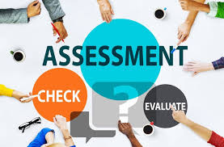
Enhancing Assessment Methods
Existing Assessment Methods
Alternative Assessment Strategies
Developing Authentic Assessments
Goal – Explore how authentic assessments can better prepare students for their careers.
Notes:
“We examined traditional and alternative assessments, with an emphasis on authentic assessments that mirror real-world tasks and promote critical thinking.”
Here’s a breakdown of the key assessment-related concepts from your presentation, along with definitions and suggested content to share during that section:
🔍 1. Existing Assessment Methods
Definition: Traditional or currently used techniques to evaluate student learning and performance.
Examples to Share:
Quizzes and Exams – Multiple choice, short answer, or essay-based.
Assignments and Papers – Individual or group written work.
Discussion Boards – Participation and quality of contributions.
Rubrics – Standardized scoring guides for consistency.
Course Success Metrics – DFW (Drop, Fail, Withdraw) rates, learning outcome data.
Discussion Prompt:
“Which of these methods do you rely on most, and how effective have they been in measuring true student understanding?”
🔄 2. Alternative Assessment Strategies
Definition: Non-traditional methods that provide more flexible, inclusive, and often more engaging ways to assess learning.
Examples to Share:
Project-Based Learning – Real-world tasks or simulations.
Portfolios – Collection of student work over time.
Peer and Self-Assessment – Students evaluate their own or others’ work.
Open-Book or Take-Home Exams – Focus on application over memorization.
Interactive Tools – Use of tools like Kahoot, Padlet, or H5P for formative assessment.
Discussion Prompt:
“What alternative assessments have you tried, and how did students respond to them?”
🧪 3. Developing Authentic Assessments
Definition: Assessments that mirror real-world tasks and require students to apply knowledge in practical, meaningful ways.
Key Characteristics:
Realistic Contexts – Simulate workplace or community scenarios.
Higher-Order Thinking – Require analysis, synthesis, and evaluation.
Student-Centered – Allow choice and creativity.
Performance-Based – Demonstrate skills through action (e.g., presentations, case studies, role plays).
Examples to Share:
Creating a business plan or marketing strategy.
Analyzing a case study and presenting solutions.
Designing a product prototype or digital campaign.
Discussion Prompt:
“How might authentic assessments better prepare students for their careers?”

Slide 18
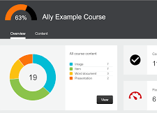
Ensuring Accessibility and Inclusivity
Importance of Accessibility
Accessibility Guidelines and Best Practices
Creating Inclusive Learning Environments
Notes:
“Accessibility is non-negotiable. We implemented best practices like captioning, accessible documents, and inclusive design to support all learners.”
Ensuring that course design and content are accessible is essential for creating an inclusive learning environment where all students—regardless of ability—can succeed. Here's an explanation of its importance and practical ways faculty can make their content more accessible:
🌍 Why Accessibility Matters in Course Design
Equity and Inclusion
Accessibility ensures that students with disabilities (e.g., visual, auditory, cognitive, or motor impairments) have equal access to learning materials and opportunities.
Legal Compliance
Institutions must comply with laws like the Americans with Disabilities Act (ADA) and Section 508 of the Rehabilitation Act, which mandate accessible digital content.
Universal Design for Learning (UDL)
Designing for accessibility benefits all learners, not just those with disabilities. For example, captions help non-native speakers and students in noisy environments.
Improved Learning Outcomes
Accessible content is often clearer, better organized, and easier to navigate, which enhances learning for everyone.
🛠️ Ways Faculty Can Ensure Accessible Course Content
1. Use Accessible Document Formats
Use headings, lists, and alt text in Word, PowerPoint, and PDFs.
Ensure documents are readable by screen readers.
2. Caption and Transcribe Multimedia
Provide closed captions for videos.
Offer transcripts for audio content.
3. Design with Color and Contrast in Mind
Use high-contrast color schemes.
Avoid using color alone to convey meaning (e.g., red for wrong, green for right).
4. Structure Content Clearly
Use descriptive titles, consistent layouts, and logical navigation.
Break content into digestible sections with clear labels.
5. Use Accessible Learning Management System (LMS) Features
Use built-in tools in platforms like Canvas, Blackboard, or Moodle that support accessibility.
Enable keyboard navigation and screen reader compatibility.
6. Provide Multiple Means of Engagement
Offer content in varied formats (text, video, audio).
Allow students to demonstrate learning in different ways (e.g., written, oral, visual).
7. Run Accessibility Checks
Use tools like Microsoft Accessibility Checker, WAVE, or Ally to scan and improve content.

Slide 19
Share your Experiences
What are some innovative assessment methods you’ve tried or would like to try?
How do you currently assess the accessibility of your courses?

Slide 20
Resources and Professional Development
Course Enhancement Plan
Course level and Instructor level data
Student Engagement Strategies
Course Design Best Practices
Course Accessibility Guides and ITE Support
ITE Professional Development – BUS PD Channel
Notes:
“We centralized resources in Microsoft Teams and offered both on-demand and in-person professional development to support faculty throughout the bootcamp.”
As Chair of the Business Administration Department, I established a Microsoft Teams channel to serve as a centralized hub for sharing key information, resources, and facilitating collaboration on departmental initiatives. For the Summer Course Refresher Bootcamp, I created a dedicated folder within the channel that housed all relevant materials, including compiled data, departmental goals, and communications shared with faculty throughout the process. This Teams channel is also used as a standard practice to provide ongoing access to departmental resources, promote transparent communication, and support faculty development.

Slide 21
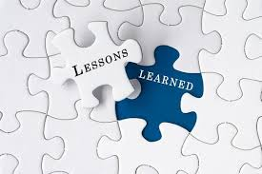
Outcomes and Lessons Learned
Key Findings from the Bootcamp
  Outcomes
  Impact
  Lessons Learned
What worked well
Notes:
“The bootcamp led to measurable improvements in course design and faculty engagement. We learned that structured support and collaboration are key to success.”
Here are presentation-ready talking points to help you explain how the Summer Course Refresher Bootcamp went and what was learned from the experience:
🎯 Key Findings from the Bootcamp
“One of the most valuable outcomes of the bootcamp was the insight we gained into our course design and delivery practices. By analyzing data and engaging in collaborative reflection, we identified both strengths and areas for growth.”
“Faculty appreciated the structured opportunity to step back and evaluate their courses with fresh eyes and peer support.”
📈 Outcomes
“We saw measurable improvements in course alignment, accessibility, and instructional strategies.”
“Faculty reported increased confidence in using technology and implementing active learning techniques.”
“Several courses were revised to better reflect current industry standards and student needs.”
🌟 Impact
“The bootcamp fostered a stronger culture of collaboration and continuous improvement within the department.”
“Students benefited from clearer learning outcomes, more engaging content, and improved accessibility.”
“Faculty engagement in professional development increased, and many expressed interest in continuing this model annually.”
🧠 Lessons Learned
“We learned that faculty need both time and structured support to engage in meaningful course revision.”
“Data-driven conversations are powerful when paired with peer collaboration and shared goals.”
“Flexibility in professional development—offering both on-demand and in-person options—was key to participation.”
✅ What Worked Well
“Weekly departmental meetings provided consistency and momentum.”
“The centralized Microsoft Teams channel streamlined communication and resource sharing.”
“The Course Enhancement Plan and reporting checklist helped faculty stay focused and organized.”
“Combining data analysis with reflective practice led to more intentional course improvements.”

Slide 22
Share your Experiences
What metrics do you use to evaluate the success of course redesign efforts?
Can you share a lesson learned from a past course improvement initiative?

Slide 23
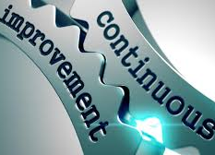
Bootcamp Conclusion and Next Steps
Action Items
Continuing Course Improvement
Opportunities for Collaboration and Support
Notes:
“We’re launching Bootcamp 2.0 this summer! It will include customized professional development and one-on-one leadership support to continue building on our progress.
Here are presentation-ready talking points to help you wrap up the session and introduce the next phase—Bootcamp 2.0—with clarity and enthusiasm:
🎤 Bootcamp Wrap-Up & Reflections
“As we wrap up the first iteration of the Summer Course Refresher Bootcamp, I want to take a moment to reflect on what we’ve accomplished together.”
“Through collaborative effort, data-informed decision-making, and a shared commitment to student success, we’ve made meaningful strides in course quality, accessibility, and instructional innovation.”
✅ Action Items Moving Forward
“Faculty will continue refining their Course Enhancement Plans based on feedback and student performance data.”
“We’ll maintain our Microsoft Teams channel as a living resource hub for ongoing collaboration and support.”
“Departmental meetings will continue to include time for sharing best practices and progress updates.”
🔄 Continuing Course Improvement
“Course improvement is not a one-time event—it’s a continuous cycle. We’ll keep using data, feedback, and reflection to guide our next steps.”
“We’ll also revisit course goals and assessments regularly to ensure alignment with evolving industry standards and student needs.”
🤝 Opportunities for Collaboration and Support
“Faculty will have access to peer mentoring, shared resources, and targeted professional development opportunities throughout the year.”
“We’ll also explore cross-disciplinary collaboration to share innovative teaching strategies and tools.”
🚀 Introducing Bootcamp 2.0 – Summer Launch
“I’m excited to announce the launch of Bootcamp 2.0 this summer!”
“This next phase will include customized professional development tailored to individual faculty needs and interests.”
“We’re also introducing one-on-one leadership support, where faculty can receive personalized coaching and guidance as they implement course enhancements.”
“Bootcamp 2.0 is about deepening our impact—building on what we’ve learned and continuing to grow together as a department.”

Slide 24
Share your Experiences
What support or resources would help you implement a similar bootcamp at your institution?
What’s one idea from today’s session you’re excited to take back to your team?

Slide 25

Questions
Thank you for joining us today!
My contact information provided via the QR code
Notes:
“Thank you for joining us today! I’d love to hear your thoughts, questions, or ideas you’re excited to take back to your own institutions.”

